Slide 1

Web scraping & data preprocessing
to gain Customer Reviews insights
12/02/2024
PPT BY-Rudra Khare

Slide 2
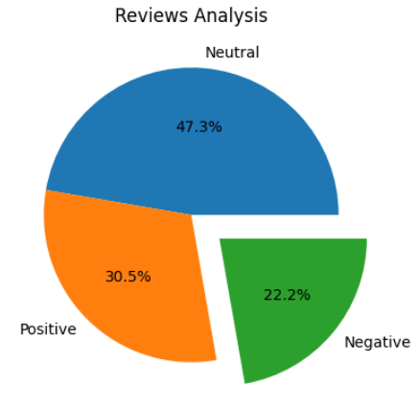
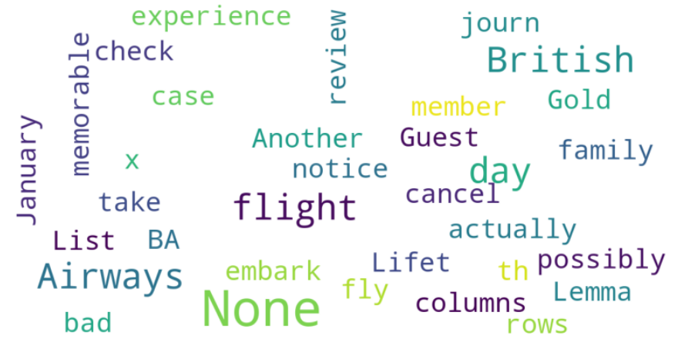
INSIGHTS FROM CUSTOMER REVIEWS
From cleaning 3749 reviews given by the customers, we obtained
Positive Reviews - 1773
Negative Reviews - 1142
Neutral Reviews – 834
Word cloud of keywords used in reviews

